Slide 1

Google Research Football with Manchester City F.C. (A Kaggle Competition)
IST 718: Big Data Analytics
Prasad Kulkarni, Carlos De Los Angeles, Calvin Kenyon

Slide 2

Summary
Project Introduction
Rule based Agent: Direct coding
Neural network
Reinforcement learning
Conclusion
Videos

Slide 3
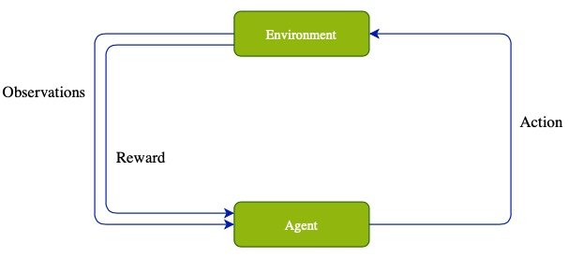
Google Football Components
Environment
Updates environment based on action.
Provides observations/rewards.
Agent
Based on observations, decides action.
Rule based, RL...
Observations
Players, ball information.
Reward
Scoring.
Moving closer to the goal.
Action
Long/short pass.
Shoot the ball.
Step
One cycle of environment -> Agent -> action.
One game is comprised of one or more steps.

Slide 4
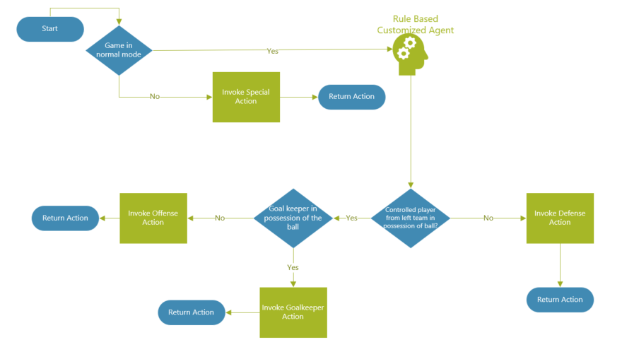
Rule Based Agent: Direct Coding Approach

Slide 5
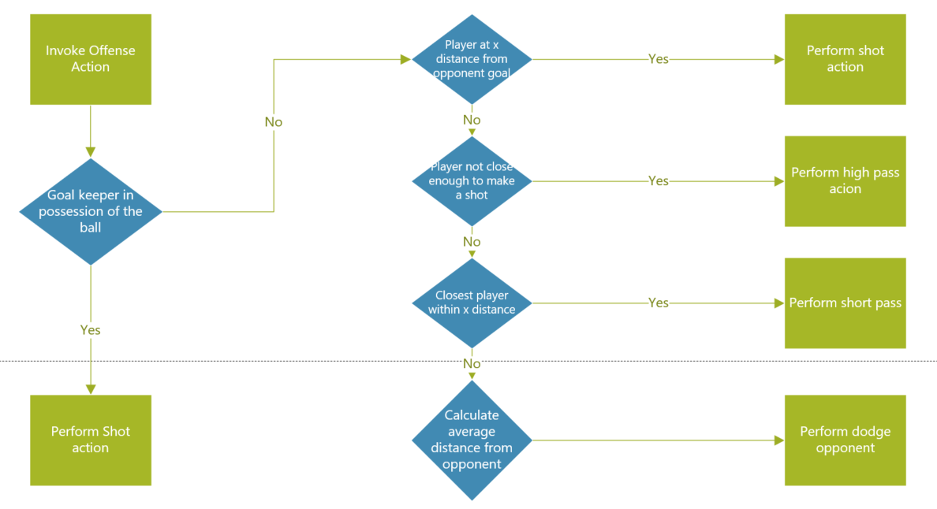
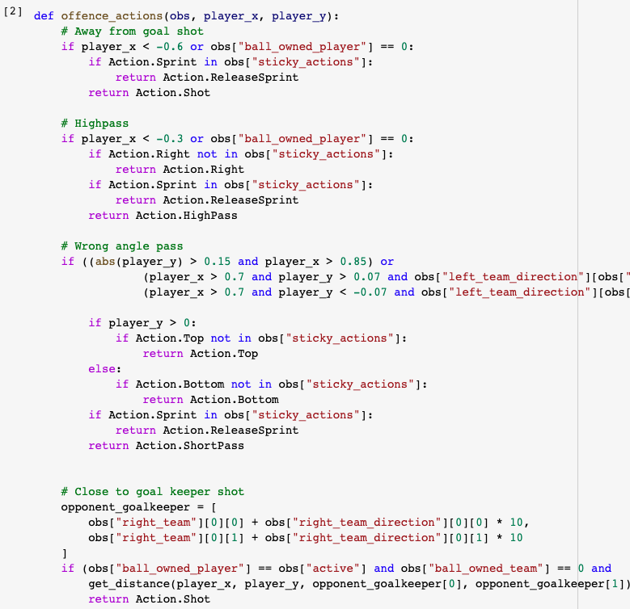
Rule Based Agent : Offense & Goalkeeper Actions

Slide 6
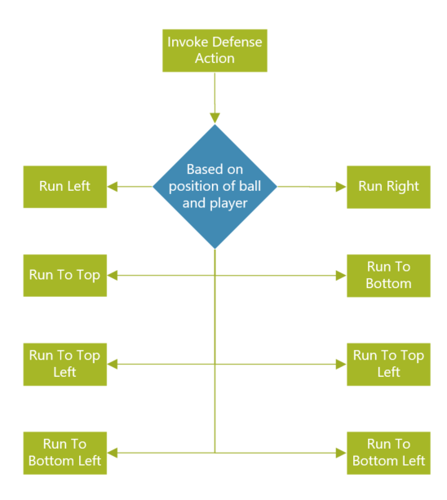
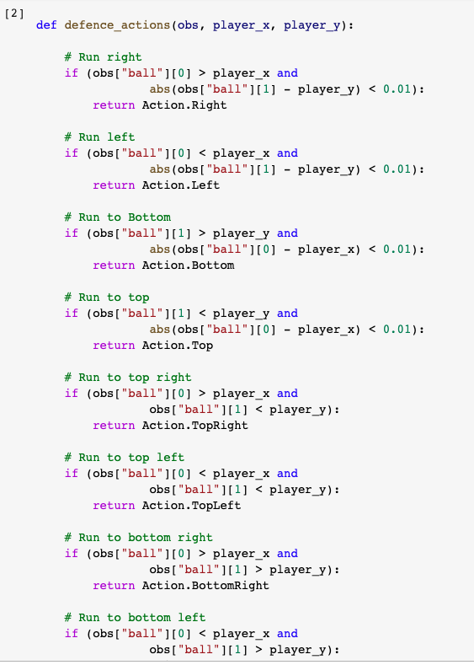
Rule Based Agent : Defense Actions

Slide 7
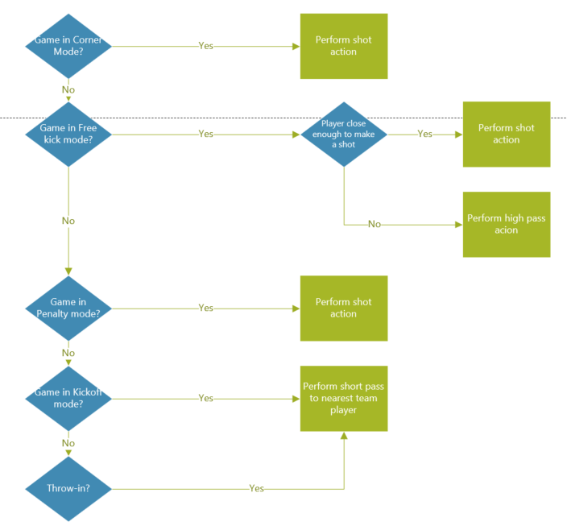
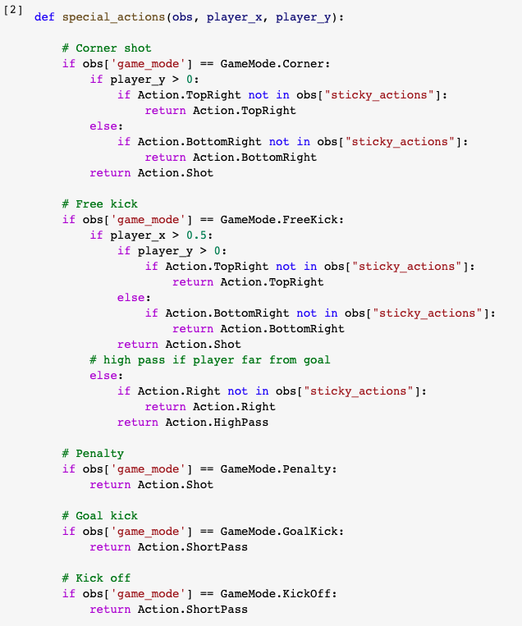
Rule Based Agent : Special Actions

Slide 8
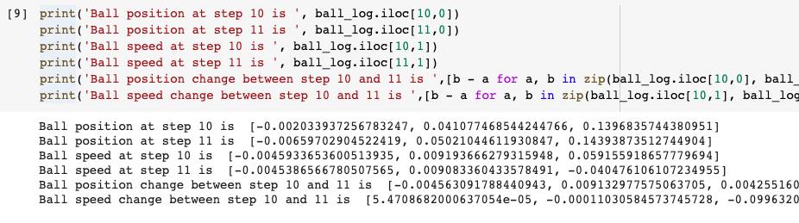

Analysis
Here we performed some analysis on log file data loaded into pandas dataframe; like gravity constant and step length of player to make the agent behave closer to the real game.
Here Gravity Constant is 0.099

Slide 9
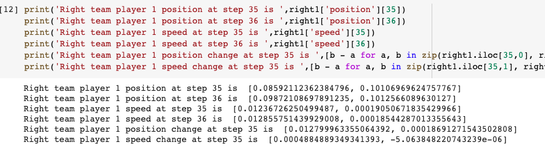
Analysis
Here we performed some analysis on log file data loaded into pandas dataframe; like gravity constant and step length of player to make the agent behave closer to the real game.
Here sprint speed is around 0.013 per step with ball.

Slide 10
Rule Based Agent - Conclusion
Pros :
Computationally less expensive.
Conceptually straightforward.
Cons:
Complicated to code: lot of scenarios to cover.
Always room for improvement; need constant tweaking of code.

Slide 11
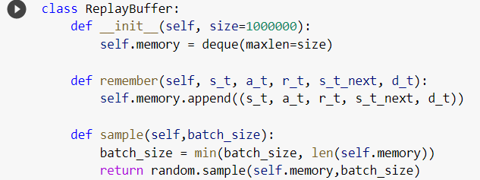
Neural Network
A neural network was designed using tensorflow and keras
Starting code was also found to assist in the model
Utilized a replay buffer, epsilon and Q-Value

Slide 12
Epsilon and Q-Value
Epsilon is a value that is assigned to the agent and if the program is not using the NN this value will decrease
As the value decreases the program will utilize the NN more frequently
Q-values are established during training
As the player takes actions, the replay buffer will log the actions and allow the agent to evaluate previous actions
The agent will then predict future Q-Values of actions and attempt to perform the action that will maximize the Q-Value

Slide 13
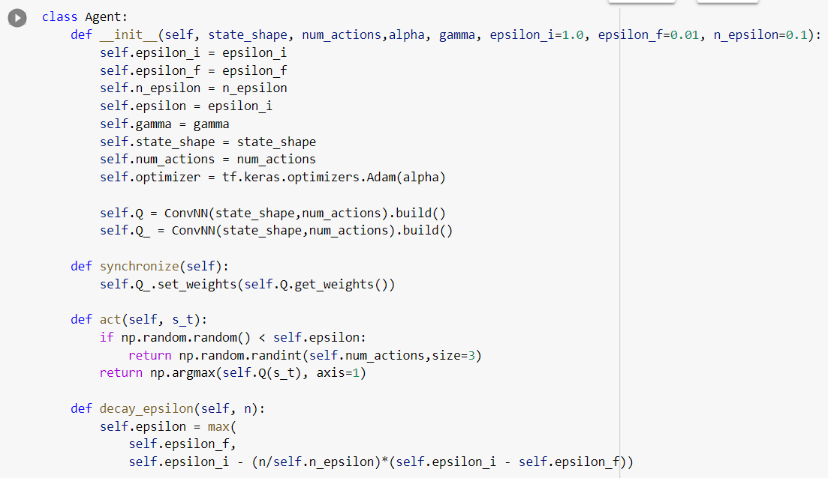
Defining Agent

Slide 14
Multiple Layers
In the beginning we split the plane layers and each plane is evaluated separately
Each action per layer passes through the weights to a middle value after which the layers are compiled back together to produce the final action the player takes
These actions are all pulled from the gfootball code

Slide 15
Training the Model
Training the model involved running it through several iterations and using the previous Q- Value on as a starting point for the next.
Base Q-weights and epsilon are then established at the end of the training
This is where we get to adjust initial epsilon and Q-weights to tweak the model
We can also add weights to each layer independently

Slide 16
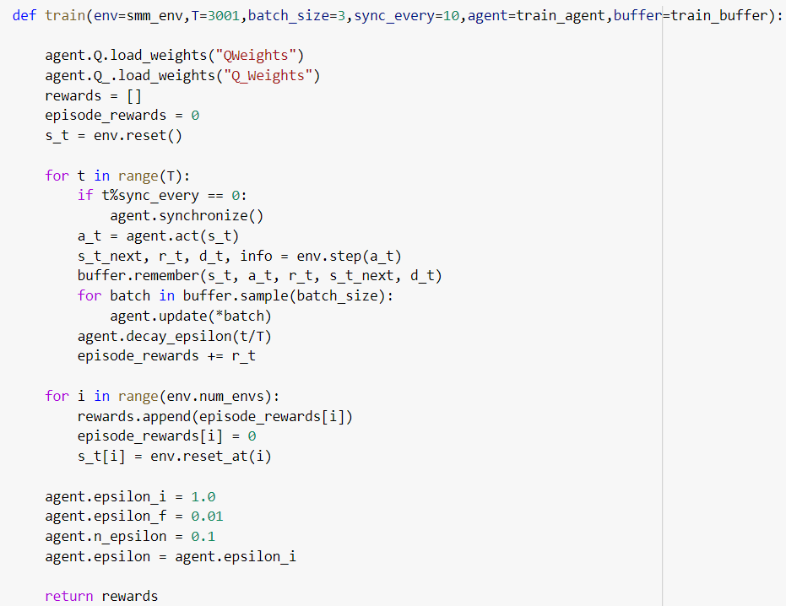
Defining the Training

Slide 17
Pros and Cons
Neural networks work more efficiently when trained in layers and then compiled together
More branching can create better accuracy on decisions, improving overall Q-Value
Fine tuning initial Q-weights and epsilon can improve training time
Checkpoints can be used to resume training from last point

Slide 18
Reinforcement Learning
Unsupervised learning through experience.
Maximize cumulative rewards.
Football presents a perfect modern task.
Scoring is a rare event.
Complex environment.

Slide 19
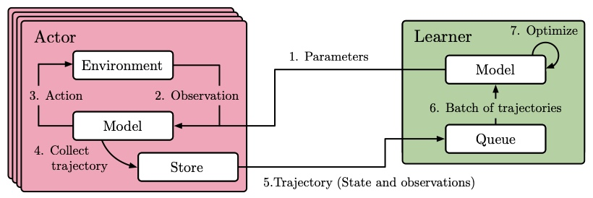
Impala Distributed Architecture
Opportunities:
Using CPUs for neural network inference.
Inefficient resource utilization.
Bandwidth requirements.

Slide 20
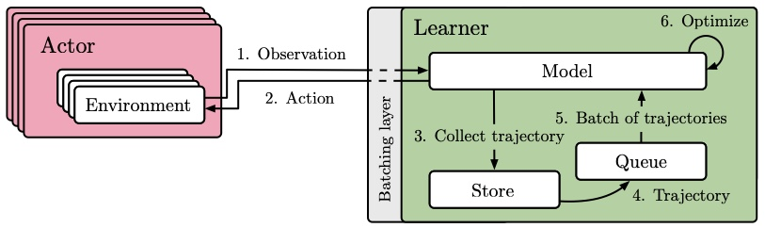
SEED RL Architecture
Improvements:
Single responsibility.
Ability to optimize for task.
Improved bandwidth.

Slide 21
RL Training
16 actors.
10 million steps trained.
Convolutional Neural Network.
ReLU activation function.
Adam optimizer.
0.00048 learning rate.
10 hours of training time.

Slide 22
Rule Based vs RL Agent

Slide 23
Sparse Rewards -Advanced Techniques
Dedicated Neural Network to learn scoring.
Gradual reward reduction of checkpoint actions.

Slide 24
RL Agent - Conclusion
Pros :
Unsupervised learning of complex tasks.
High level of skill.
Close to how humans learn (trial and error).
Cons:
Computationally expensive.
Training times.
Sparse rewards presents a challenge.

Slide 25
Summary
Rule based.
Easy to reason about and inexpensive compute.
Limited agent expertise.
Neural Network
Great potential for agent skill.
Lack of framework for learning.
Reinforcement Learning
Closer to how humans learn.
More work to be done.
Learning from scratch every time.

